Slide 1

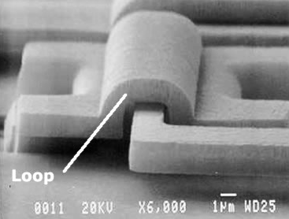
Control Chart Basics
Support Center for
Microsystems Education
-SCME-
2017
scme-support.org

Slide 2
SCME is a National Science Foundation Advanced Technological Education (ATE) Support Center at the University of New Mexico.
We offer professional development and educational materials to excite and engage community college, university, and high school students and faculty in the field of Microsystems (Micro Electro Mechanical Systems, MEMS) technology.
Support for this work was provided by the National Science Foundation's Advanced Technological Education (ATE) Program through Grants #DUE 1205138 & 1700678 .
SEM of Loop and Hinge System Courtesy of Sandia National Laboratories
scme-support.org

Slide 3
Objectives
Normal distribution and how it is significant in X-charts
X-charts and how to create them
Interpreting Control Charts by applying the Shewhart rules
scme-support.org
Notes:
Topics included in this presentation are process variation and the different types of variation that one might see in a process, what is SPC, the tools used in SPC, the normal distribution which you probably already know as the bell curve, controls charts (specifically the xbar chart), and how to interpret these charts. So let’s get started shall we?

Slide 4
Let’s Have Fun with Control Charts!
X -Chart
Upper Control Limit
Centerline
X
(Target)
Lower Control Limit
Notes:
Now, How does this statistical data from the sample help us to create our control charts?
There are many types of charts used to monitor different types of data. It is very common in industry to base the limits for controlling the process on the SAMPLE mean, X bar. This type of chart is commonly referred to as a Mean or X bar-Chart. When this type of chart is used, the middle line, or the centerline is the mean of the sample means (or x bar bar). The red lines here are the upper control limit (UCL) and lower control limit (LCL). The upper control limit can be calculated or set many ways, but most commonly it is the mean plus 3 sigma or 3 standard deviations for the upper control limit and the mean minus 3 standard deviations for the lower control limit.
As you can see, setting up a control chart can be very easy and practical, you just have to be familiar with basic statistical calculations that we did previously and have access to the process data.

Slide 5
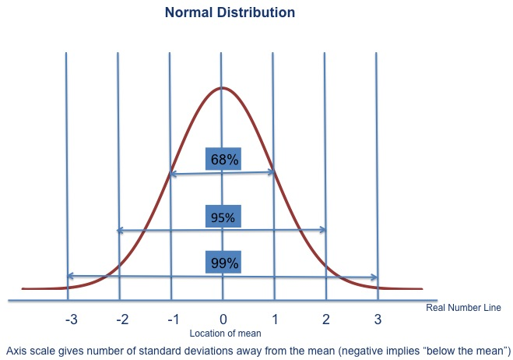
Normal Distribution
Yes, it does matter
σ
σ
σ
σ
σ
σ
Notes:
Let’s introduce the control X bar chart with a brief discussion on Normal Distribution. When considering process data, it is important to understand the nature of your data, how it behaves and how it is distributed. In statistical terms, this is called the probability distribution of the data set. There are many different types of probability distributions, but the scope of this webinar will focus on a continuous normal distribution. A normal distribution is most often assumed because most process data is distributed normally, or at the very least, a normal distribution can be a good approximation.
You may ask yourself if it is important to understand whether or not the data follows a normal distribution. But the SPC charts we are discussing here are based upon the ASSUMPTION that the data is distributed normally. While troubleshooting or trying to understand a process it may be useful to recall that a normal distribution of the data is the basic assumption and the data produced by your process may not be behaving “normally” so to speak. So just keep that in mind!
A normal distribution follows a bell-shape pattern. A normal distribution is shown here with the vertical lines signifying numerical values at one (1), two (2), and three (3) standard deviations (s) above and below the mean.
The well-known bell-shaped curve has the following important properties:
It is symmetrical about its mean. The mean is central in the distribution of data values. It is at the apex of the curve.
The width of the bell-shaped curve increases as the standard deviation increases and decreases as the standard deviation decreases.
Approximately 68% (68.26%) of the data will be within one standard deviation on either side of the mean
Approximately 95% (95.44%) of the data will be within two standard deviations on either side of the mean
Approximately 99% (99.74%) of the data will be within three standard deviations on either side of the mean.

Slide 6
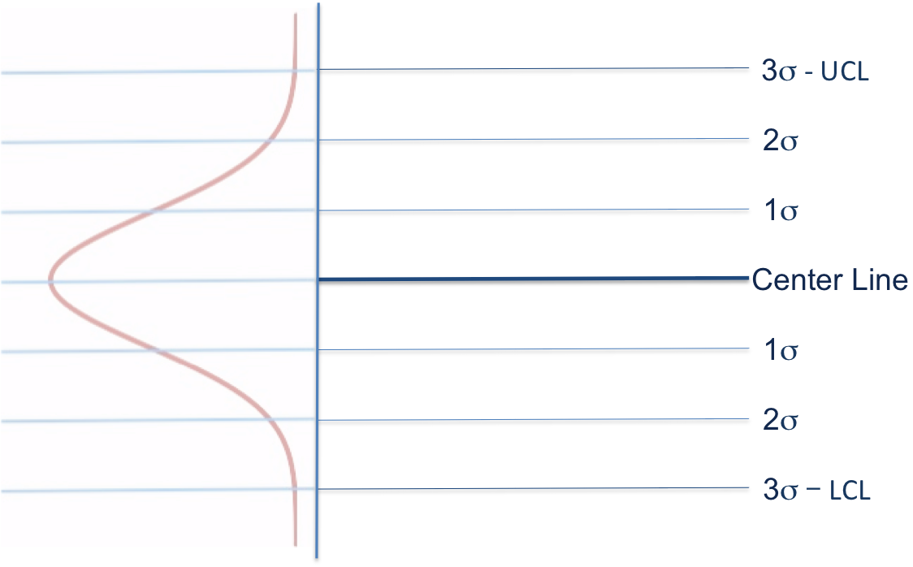
Control Chart Basics
X -Chart
Upper Control Limit
+ 3σ
μ + 2σ
μ + 1σ
Target
X
μ − 1σ
μ − 2σ
− 3σ
Lower Control Limit
Notes:
Now how does this apply to control charts? Mean or Xbar-charts can be used for both variables and attributes data. Variables data is more commonly used for statistical control than attributes data but regardless of the type of data, the basic form of the control chart is the same. The chart has a centerline or target. As stated earlier, the Xbar-chart uses the sample mean as the centerline. This mean is initially calculated using hundreds of data points from the process. There are one or more control lines that are drawn above and below the centerline. The control lines are determined by a certain number of standard deviations away from the centerline or target. It is important that both the centerline and the standard deviation be correctly calculated and defined because the decision as to whether the process is in or out of control will be determined by the data within or outside of these values.
Recall our discussion of the normal distribution. Let’s flip this normal distribution curve on its side and develop the X bar-chart. Again, the centerline is the mean and the upper and lower control limits are the mean plus and minus 3 standard deviations respectively. The mean plus and minus 2 standard deviations are sometimes used as warning limits.

Slide 7
Control Chart Basics
X axis is time based
Monitors process to detect special cause variation and manage common cause variation
Common Cause Variation
  Due to room temperature change
  Line personnel
Special Cause Variation
  Changes in process
  Unexpected events
  Change in vendors of a product ingredient
  Leaks in a vacuum line
Notes:
The x-axis of the control chart is time based. The process is monitored over time in order to evaluate if the process is experiencing common cause variations or special cause variations. Common cause variations are attributed to things that we would expect (e.g., change in manufacturing room temperature or line personnel). Special cause variations are variations that are caused by changes, extremes or unexpected events (e.g., change in vendors of a product ingredient, low level coolant, leaks in a vacuum line). If the process is experiencing only common cause variation, the data points should fall within this range. Plus or minus 3 SDs.

Slide 8
Control Chart Basics
X -Chart
Notes:
Based upon what we know about normal distributions and the basic statistics we just covered, we can create our control chart!!

Slide 9
Control Chart Basics
X -Chart
UCL
+ 3σ
Target
X
LCL
− 3σ
Notes:
The mean of the data, or Xbar is again the centerline which we will call the Target. The Upper control limit is the mean plus 3 times sigma. The Lower control limit is the mean minus 3 times sigma.

Slide 10
Control Chart Basics
X or μ
= 3.00 microns
X -Chart
σ
UCL
+ 3σ
3 + (3*0.1)= 3.03
= 0.1 microns
Target = 3.00
X
LCL
− 3σ
3 - (3*0.1)= 2.97
Notes:
Using the sample data from earlier, that sample mean was 3.00 microns and the sample standard deviation was 0.1 microns. So in our Example the upper control limit is 3.03 microns and the lower control limit is 2.97 microns.
Now we have a control chart set up for monitoring Resist Thickness deposition.

Slide 11
Control Chart Basics
X or μ
= 3.00 microns
X -Chart
σ
UCL
+ 3σ
3 + (3*0.1)= 3.03
= 0.1 microns
μ + 2σ
μ + 1σ
99%
Target = 3.00
X
μ − 1σ
μ − 2σ
LCL
− 3σ
3 - (3*0.1)= 2.97
Notes:
We would expect 99.74 percent of the data to fall between 3.03 and 2.97 microns, about 95.44% of the data to fall within the sample mean plus and minus 2 standard deviations, and 68.26% of the data to fall between the mean plus and minus 1 standard deviation.
Remember that the centerline and the upper and lower control limits on this graph were calculated using a sample of collected data points. It is better to have as much data in the sample as you can when you calculate these parameters. This is because this data sample is used to calculate the parameters within which to determine whether or not the process is in control. Therefore, hundreds of random data samples are collected over a period of time that represents several process runs that incorporate all of the factors that contribute to the “background noise” or variation of the process.

Slide 12
Control Chart Basics
X or μ
= 3.00 microns
X -Chart
σ
UCL
+ 3σ
3 + (3*0.1)= 3.03
= 0.1 microns
μ + 2σ
μ + 1σ
95%
99%
Target = 3.00
X
μ − 1σ
μ − 2σ
LCL
− 3σ
3 - (3*0.1)= 2.97
Notes:
We would expect 99.74 percent of the data to fall between 3.03 and 2.97 microns, about 95.44% of the data to fall within the sample mean plus and minus 2 standard deviations, and 68.26% of the data to fall between the mean plus and minus 1 standard deviation.
Remember that the centerline and the upper and lower control limits on this graph were calculated using a sample of collected data points. It is better to have as much data in the sample as you can when you calculate these parameters. This is because this data sample is used to calculate the parameters within which to determine whether or not the process is in control. Therefore, hundreds of random data samples are collected over a period of time that represents several process runs that incorporate all of the factors that contribute to the “background noise” or variation of the process.

Slide 13
Control Chart Basics
X or μ
= 3.00 microns
X -Chart
σ
UCL
+ 3σ
3 + (3*0.1)= 3.03
= 0.1 microns
μ + 2σ
μ + 1σ
68%
95%
99%
Target = 3.00
X
μ − 1σ
μ − 2σ
LCL
− 3σ
3 - (3*0.1)= 2.97
Notes:
We would expect 99.74 percent of the data to fall between 3.03 and 2.97 microns, about 95.44% of the data to fall within the sample mean plus and minus 2 standard deviations, and 68.26% of the data to fall between the mean plus and minus 1 standard deviation.
Remember that the centerline and the upper and lower control limits on this graph were calculated using a sample of collected data points. It is better to have as much data in the sample as you can when you calculate these parameters. This is because this data sample is used to calculate the parameters within which to determine whether or not the process is in control. Therefore, hundreds of random data samples are collected over a period of time that represents several process runs that incorporate all of the factors that contribute to the “background noise” or variation of the process.

Slide 14
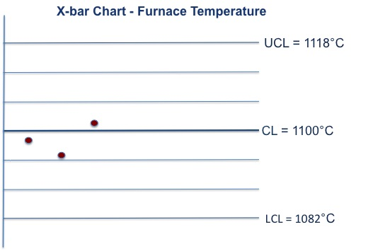
Control Chart Basics
Average
Notes:
Let’s look at another example. This graph represents the Average Run process temperature data of a diffusion furnace used to fabricate MEMS .
Over several thousands of temperatures collected from the process diffusion furnaces, it was found that the mean temperature was 1100° C. The standard deviation for the collected temperatures was 6° C. Therefore, the upper and lower control limits are the mean ±3 σ or 1118° C and 1082°C, respectively. That tells us, that when oven temperatures are randomly collected during the process, the mean of those collected temperatures should fall, 99% of the time, between 1118° C and 1082°C.
So let’s collect some data. Part of your job is to record an average run temperature for each process run. So this chart shows three average run temperatures for 3 different runs. For example, let’s say that your three average run temperatures were 1098 °C, 1095 °C, 1101 °C. Take those data points and plot them on the graph. Your plot should look like the one below. What would you say about the process temperatures that you just plotted? Your temperatures definitely fell within the upper and lower control limits; actually, they were within ±1σ from the mean. Therefore, the furnace temperatures are behaving the way you would expect them to.
The control limits should be revised whenever a product change occurs. A change can be the result of a process fix or a spontaneous change. Limits should never be changed to accommodate an unstable process. Limits should also be periodically examined and revised accordingly.

Slide 15
Shewhart Rules aka Western Electric Rules (WECO)
8 Rules to Signal an Out of Control Process
  Developed by a Western Electric Engineer – Walter Shewhart
Rule 1: A single point outside the μ±3σ zone.
Rule 2: Two out of three successive points outside μ±2σ zone.
Rule 3: Four out of five successive points outside μ±1σ zone.
Rule 4: Eight or more successive numbers either strictly above or strictly below the mean (the center).
Rule 5: Six or more successive numbers showing a continuous increase or continuous decrease.
Rule 6: Fourteen or more successive numbers that oscillate in size (i.e. smaller, larger, smaller, larger)
Rule 7: Eight or more successive numbers that avoid μ±1σ zone.
Rule 8: Fifteen successive points fall into μ±1σ zone only, to either side of the centerline.
Notes:
Now let’s talk about how these control charts can help us to determine when a process is out of control or not behaving the way it should. The whole point of control charts is to be able to monitor data from a process to see if it is experiencing only common cause or expected/normal variation. Control Charts are designed to signal once the process starts experiencing Special Cause Variation, or NOT behaving as it should, this is referred to as a process going out of control.
In the 1920’s, an engineer form Western Electric named Walter Shewhart introduced the basic concept of Control Charts. Shewhart was able to identify the importance of the reduction of variation in a process. In order to achieve continuous improvement he stressed the necessity of understanding and reducing this variation. He introduced a Control Chart as a tool to bring a process into a state of statistical control.
Walter Shewhart came up with eight rules that are commonly used in industry today. The eight Shewhart rules (also referred to as Western Electric Rules) are used, as signals that can suggest that the data we are receiving is not what would be expected if only common causes of variation were present. In other words, the rules are tests for special cause variation.
The process is said to be in statistical control if and only if the variation is only due to common causes. If one or more of the above rules is broken, this indicates a special cause variation and the process is not exhibiting statistical control or is said to be Out of Control (OOC). If the process is out of control, the next step is to look for the root cause of the special cause variation and then remove this cause to bring the process back into statistical control.
Let’s look at each of these Rules in Detail.

Slide 16
Shewhart Rules – Rule #1
A
B
C
C
B
A
Rule 1: The existence of a number that is not in any of the zones labeled A, B, and C.
(See special, encircled point above.) This would be a single point outside the μ±3σ zone.
Notes:
Let’s define some zones to make clarification of the Shewhart rules a little easier. Zone A is the mean plus or minus 3 sigma, Zone B is the mean plus or minus 2 sigma, and zone C is the mean plus or minus 1 sigma.
Ok Rule number 1 is when there is a single point that is not in any of the zones labeled A, B, and C.
(See special, encircled point above.) This would be a single point outside the μ±3σ zone.

Slide 17
Shewhart Rules – Rule #2
A
B
C
C
B
A
Rule 2: Two out of three successive numbers in a zone A or beyond (by beyond we mean away from the mean). This would be two out of three successive points outside μ±2σ zone.

Slide 18
Shewhart Rules – Rule #3
A
B
C
C
B
A
Rule 3: Four out of five successive numbers in a zone B or beyond. This would be four out of five successive points outside μ±1σ zone.

Slide 19
Shewhart Rules – Rule #4
Rule 4: Eight or more successive numbers either strictly above or strictly below the mean (the center).
A
B
C
C
B
A

Slide 20
Shewhart Rules – Rule #5
A
B
C
C
B
A
Rule 5: Six or more successive numbers showing a continuous increase or continuous decrease.

Slide 21
Shewhart Rules – Rule #6
Rule 6: Fourteen or more successive numbers that oscillate in size (i.e. smaller, larger, smaller, larger)
A
B
C
C
B
A

Slide 22
Shewhart Rules – Rule #7
A
B
C
C
B
A
Rule 7: Eight or more successive numbers that avoid zone C.

Slide 23
Shewhart Rules – Rule #8
Rule 8: Fifteen successive points fall into zone C only, to either side of the centerline.
A
B
C
C
B
A

Slide 24
Type I and Type II Errors
2 Types of Errors: Type I and Type II
Type I – False Alarm
  Decision rules lead you to decide that special cause variation is present when in fact it is not present.
Type II – Miss
  Decision rules lead you not to decide that special cause variation is present when in fact it is present.
Notes:
In the context of control charts, there are two types of errors: Type I error and Type II error.
Type I error occurs when the decision rules (e.g. Shewhart rules) lead you to decide that special cause variation is present when in fact it is not present. This would be a false alarm.
Type II error occurs when the decision rules lead you not to decide that special cause variation is present when in fact it is present. This would be a miss.

Slide 25
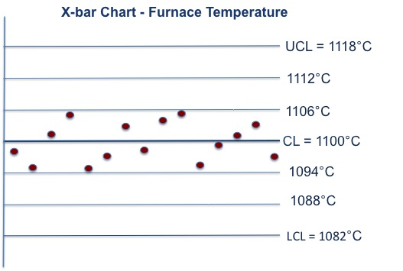
Question: Let’s test the rules
Rule 1: A single point outside the μ±3σ zone.
Rule 2: Two out of three successive points outside μ±2σ zone.
Rule 3: Four out of five successive points outside μ±1σ zone.
Rule 4: 8 or more successive numbers either strictly above or strictly below the mean.
Rule 5: 6 or more successive numbers showing a continuous increase or continuous decrease.
Rule 6: 14 or more successive numbers that oscillate in size (i.e. smaller, larger, smaller, larger)
Rule 7: 8 or more successive numbers that avoid μ±1σ zone.
Rule 8: 15 successive points fall into μ±1σ zone only, to either side of the centerline or target.
Notes:
Let’s take our previous example of furnace temperatures and see if you can use the Shewhart rules to determine if the process is in control. You have collected more data and plotted them on the SPC chart. Keep in mind that each data point is the average of 3 random temperature readings taken each hour of the process. Is this process in control? If not, which Shewhart rule did the data violate?

Slide 26
Question: Let’s test the rules
Rule 1: A single point outside the μ±3σ zone.
Rule 2: Two out of three successive points outside μ±2σ zone.
Rule 3: Four out of five successive points outside μ±1σ zone.
Rule 4: 8 or more successive numbers either strictly above or strictly below the mean.
Rule 6: 14 or more successive numbers that oscillate in size (i.e. smaller, larger, smaller, larger)
Rule 7: 8 or more successive numbers that avoid μ±1σ zone.
Rule 8: 15 successive points fall into μ±1σ zone only, to either side of the centerline or target.
Notes:
If you said that the process was out of control, you were correct. The fifteen data points were all in within ±1σ from the centerline. This is a violation of Rule 8.
But the reality of this particular process is that even though it is considered out of control, it is out of control in a good way. It’s showing that over time, the variation of the equipment has actually reduced. A problem solving team would probably be required for this one because they would need to determine what changed that caused a reduction in variation and since it is over a 15 hour period, it could be due to several factor and not just one.

Slide 27
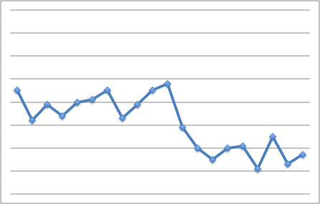
Process Changes - Shift
Shift – When the data starts to center around a different mean or center line.
3σ - UCL
Centerline
or Target
New mean of shifted data
3σ - LCL
Notes:
There are many instances when your control chart may not produce an out of control (OOC) signal, but the process may be shifting, trending or cycling within the control limits. It is important to be aware of these types of changes regardless of the rules you are using to declare your process out of control. There are three different patterns that could indicate a change in the process.
The first of these is a shift, when the mean of the process actually shifts to a new value.

Slide 28
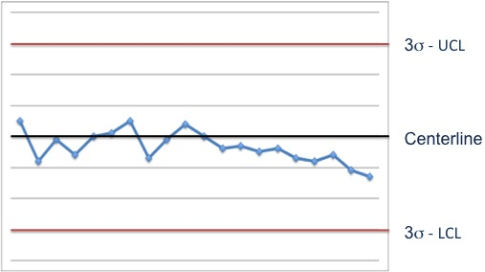
Process Changes - Trend
Trend – When the process mean begins to gradually move in one direction.
or Target

Slide 29
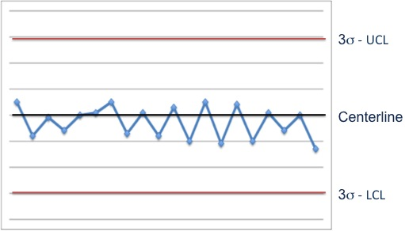
Process Changes - Cycle
Cycle – When the data begins to increase or decrease
in a cyclical or repetitive manner.
or Target
Notes:
It is always important to keep an eye on the process and notice any changes that are out of the ordinary. A shift in the mean, trending data, and data cycling in a repetitive manner are only a few examples of how data can indicate a process changing. Remember, understanding process variability is a key to a quality product!

Slide 30
Out of Control Action Plan - OCAP
You are a technician in the photolithography aisle of a local MEMS fabrication facility. After randomly testing several wafers from the last processing batch and plotting the data on a control chart, you identify an out-of-control situation with resist thickness.
3σ
UCL
2σ
Photoresist
Thickness
1σ
Target
1σ
2σ
3σ
LCL
Too thick?
Yes
Put DOWN the Machine
and TS the problem
Run a boat of test wafers, remeasure, plot.
Photoresist Too Thick?
Release the machine for production and determine the cause of the out-of-control situation
No
Notes:
So what do you do when you’ve identified an out of control process? Now it is time to employ some problem solving techniques. A specific problem solving strategy that is used in industry, specific to a SPC chart detecting a process out of control, is an Out of Control Action Plan or OCAP
Looking at the situation you have on this slide - You are a technician in the photolithography aisle of a local MEMS fabrication facility. After randomly testing several wafers from the last processing batch and plotting the data on a control chart, you identify an out-of-control situation with resist thickness.
Normally in an out-of control situation like this, the technician would first complete the Out of Control Action Plan (OCAP). Here is a short example of such a procedure. In industry, it would be more extensive than this, but for the sake of the webinar, I’ve shortened it. The control chart has identify that the resist thickness is out-of-control by having a resist measurement above the upper control limit. The OCAP says to run a boat of test wafer, remeasure and plot. If the resist thickness is no longer too thick, the release the machines for production and determine the cause of the out-of-control situation (because apparently it has corrected itself, but you don’t want a repeat). (next slide)

Slide 31
Out of Control Action Plan - OOCAP
Too thick?
Yes
Put DOWN the Machine
and TS the problem
Photoresist Too Thick?
Run a boat of test wafers
Release the machine for production and determine the cause of the out-of-control situation
No
Recognize the a Problem Exists
Evaluate Possible Causes
Analyze the Problem
Develop an Action Plan
Identify Possible Causes
Verify and Record
Notes:
So what IF the test wafers do come out with resist thickness that is too thick? At this point the technician would put down the machine and troubleshoot the problem using a systematic approach to problem-solving. If you missed our last webinar, we went through this problem, using the six steps to problem-solving that you see here. So if you want to know why the resist was too thick, check out the webinar on Problem-solving for Technicians.

Slide 32
Data Collection/Analysis Plan
Start
Is your
process in
control?
NO
A
Analyze the process
for the out of control
data point.
(Look at methods,
equipment, people,
materials, environment)
Take 5 temperature
measurements during
the process
YES
Process is
In control!
Determine the
cause of the out
of control data point.
Average the 5 run
temperatures to get
an X-bar value
Plot the X-bar value
on the chart
Correct the cause
A
Notes:
This is an OCAP that is used could be used for monitoring the temperature of an oxidation furnace. Let’s go through it.

Slide 33
Control Limits are NOT Specification Limits
Control Chart Centerline
  Derived from real-time process data
Control Limits
  Derived from real-time process data
Specification Limits (Spec Limits)
  Boundaries that a product is acceptable or not acceptable
Just because a process is in statistical control does not mean it is always within spec and vise versa
SPC has to do with process predictability
Process Specification Limits have to do with the process capability
General Rule: Do not put Specification Limits in a control chart!
Notes:
As we previously discussed, the control chart centerline (mean) and control limits (standard deviation) are derived from real-time process data. Specifications, however, are the boundaries at which a product is said to be acceptable or not acceptable, not defective or defective. A process can be in statistical control but may be producing a product that is not within specifications. The opposite can also happen. A process may be statistically out of control, but producing products that are within specifications. It is the role of the process and product design teams to setup a process that is “in control” and producing a product “within specifications”. Generally, it is the role of the manufacturing engineer and technician to keep the process “in control” and the role of a process or quality assurance team to make sure that a controlled process is meeting specifications.
A process that has small enough variation to meet specifications consistently exhibits capability. Statistical process control has to do with process predictability. Process capability has to do with consistency and meeting specifications.
Process Spec limits are parameters that define acceptable performance for a process expressed as a target limit as well as an upper and lower limit.
As a general rule, specification limits are NOT put on a control chart! The reason is this is a tendency for people to put all of their attention only on how well the process is doing relative to specifications and to ignore the control limits. Purposes of the control chart are to detect special cause variation, which destroys process predictability, and to detect and prevent process problems before they occur. If all the emphasis is placed on the specification limits, there will be little attention to the chart, the control limits, and variation in processes. The "voice of the process" will be ignored and before you know it, you have a process that has been tweaked to death and is so far out of control, that you have to shut it down!

Slide 34
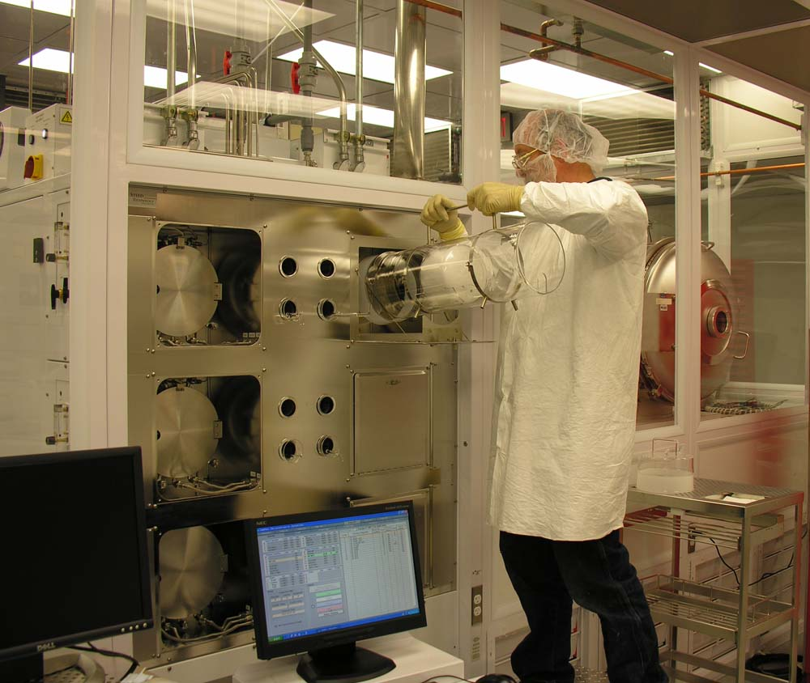
EXAMPLE – SiO₂ Growth
Silicon Dioxide Growth for a Sacrificial Layer on a MEMS device
Specification states that the Average Run Temperature (X) should be 1000°C ± 10°C
Image courtesy of UNM MTTC
Notes:
Let’s put your knowledge of SPC to work. Here we have an oxidation furnace that is used to grow silicon dioxide on a silicon substrate. For this example we are growing the sacrificial layer between the substrate and the first layer of polysilicon which will become the rotor. One of the process parameters that we monitor is furnace temperature. If the temperature becomes to high, then the final oxide thickness is too thick for a programmed amount of time. If the temperature becomes too low, then the oxide thickness is too thin. So a temperature consistent with the programmed temperature is important!
The specification calls for an Average Run Temperature – 1000 plus or minus 10 Degrees, but for process control, this really isn’t important unless our initial processes are out of spec.

Slide 35
for SiO₂ Growth
X -Chart
σ = 3.77 °C
+ 3σ = 1004 + (3*3.77) = 1015°C
− 3σ = 1004 + (3*3.77) = 993°C
UCL
μ + 3σ = 1015°C
Target = 1004°C
LCL
μ − 3σ = 993°C
Notes:
When the process is initially set up, data is collected that allows the engineering team to identify the natural variation of the furnace temperature. After collecting 5 temperature means per process over 20 process runs, we end up with 100 data points or temperature means. Now we can calculate the target or the X bar bar. In the case of our furnace, the target is 1004 C. Using this data, the standard deviation is calculated and found to be 3.77 C. Using the normal distribution of plus and minus 1, 2, and 3 SD from the target, we can now design the control chart. Our OCL becomes 1015 c and the LCL is 993 C.

Slide 36
for SiO₂ Growth
X -Chart
Management has determined that this process should be monitored for only the following 4 Shewhart Rules:
Rule 1: A single point outside the μ±3σ zone.
Rule 2: Two out of three successive points outside μ±2σ zone.
Rule 4: 8 or more successive numbers either strictly above or strictly below the mean.
Rule 5: 6 or more successive numbers showing a continuous increase or continuous decrease.
Notes:
For the particular company, these 4 rules have be determine to be the most effective rules for this process. Applying all of the rules would be a nightmare! Rule 1….Rule 5….
Keeping these rules in mind, lets look at a chart.

Slide 37
for SiO₂ Growth
X -Chart
UCL
μ + 3σ = 1015°C
Target = 1004°C
LCL
μ − 3σ = 993°C
Notes:
The average run temperature has been measured 8 different times during the process for 8 different runs. Do you see a problem with this process? Do any of the Shewhart rules apply? Actually, no.
Now it is your turn to calculate and analyze the next point on the chart by finding the average run temperature for run 9. Calculate the average temperature and write it into the chat box.

Slide 38
for SiO₂ Growth
X -Chart
Rule 1: A single point outside the μ±3σ zone.
Rule 2: Two out of three successive points outside μ±2σ zone.
Rule 4: 8 or more successive numbers either strictly above or strictly below the mean.
Rule 5: 6 or more successive numbers showing a continuous increase or continuous decrease.
UCL
μ + 3σ = 1015°C
Target = 1004°C
LCL
μ − 3σ = 993°C
990°C
Notes:
So here is our new data point– 990 C. Is our process still in control? If not, which of the rules apply?
Now see if you can use the 4 rules that are to be tracked and determine if there is an out of control situation.

Slide 39
for SiO₂ Growth
X -Chart
Rule 1: A single point outside the μ±3σ zone.
Rule 2: Two out of three successive points outside μ±2σ zone.
Rule 4: 8 or more successive numbers either strictly above or strictly below the mean.
Rule 5: 6 or more successive numbers showing a continuous increase or continuous decrease.
UCL
μ + 3σ = 1015°C
Target = 1004°C
LCL
μ − 3σ = 993°C
990°C
Notes:
And yes, that was an easy one, the ninth data point is outside the Lower control limit, so the process is out of control.

Slide 40
for SiO₂ Growth
X -Chart
Rule 1: A single point outside the μ±3σ zone.
Rule 2: 2 out of three successive points outside μ±2σ zone.
Rule 4: 8 or more successive numbers either strictly above or strictly below the mean.
Rule 5: 6 or more successive numbers showing a continuous increase or continuous decrease.
UCL
μ + 3σ = 1015°C
Target = 1004°C
LCL
μ − 3σ = 993°C
Notes:
Ok, here is another one, this time you do not have to do any math, you are given average run temperatures for 10 runs, now determine based upon our rules, if there is an out of control situation.

Slide 41
for SiO₂ Growth
X -Chart
Rule 1: A single point outside the μ±3σ zone.
Rule 2: 2 out of three successive points outside μ±2σ zone.
Rule 4: 8 or more successive numbers either strictly above or strictly below the mean.
Rule 5: 6 or more successive numbers showing a continuous increase or continuous decrease.
UCL
μ + 3σ = 1015°C
Target = 1004°C
LCL
μ − 3σ = 993°C
Notes:
If you said that it is rule 4, with 8 successive data points strictly above the target value, the you are correct! This kind of problem could actually identify a mean shift in the furnace to where the temperature is consistently running hotter than the setpoint. Definitely need to investigate that.

Slide 42
for SiO₂ Growth
X -Chart
Rule 1: A single point outside the μ±3σ zone.
Rule 2: 2 out of three successive points outside μ±2σ zone.
Rule 4: 8 or more successive numbers either strictly above or strictly below the mean.
Rule 5: 6 or more successive numbers showing a continuous increase or continuous decrease.
UCL
μ + 3σ = 1015°C
Target = 1004°C
LCL
μ − 3σ = 993°C
Notes:
Let’s try this one more time. What do you see?

Slide 43
for SiO₂ Growth
X -Chart
Rule 1: A single point outside the μ±3σ zone.
Rule 2: 2 out of three successive points outside μ±2σ zone.
Rule 4: 8 or more successive numbers either strictly above or strictly below the mean.
Rule 5: 6 or more successive numbers showing a continuous increase or continuous decrease.
UCL
μ + 3σ = 1015°C
Target = 1004°C
LCL
μ − 3σ = 993°C
Notes:
Well, this time, there is no out of control situation, all looks well! It looks like the process is going to violate rule 5, but the last data point put the process back on track. So as you can see, if the operators and technicians use these control charts on a regular basis, OOC situations can be caught immediately! And there is no guessing game! The process is either in control or out of control – period!

Slide 44
Other types of Charts
X and R chart
X and s chart
p-Chart and np-chart (defectives)
U and c charts (defects)
Individuals Chart
Exponentially Weighted Moving Average (EWMA) Chart
Notes:
We’ve talked a lot about x bar charts, but there are many other types of charts, used for different purposes that you should be familiar with. The Xbar and the R chart are commonly used together, as are the Xbar and the s chart.
When charting attribute or discrete data, the p-chart and the np chart are commonly used along with the the U chart and C chart.
The Individuals Chart plots each measurement (sometimes called an observation) as a separate data point.
The EWMA is one method that is commonly used for detecting smaller shifts quickly, usually less than or equal to 1.5 standard deviations. The process mean is not necessarily a constant.

Slide 45
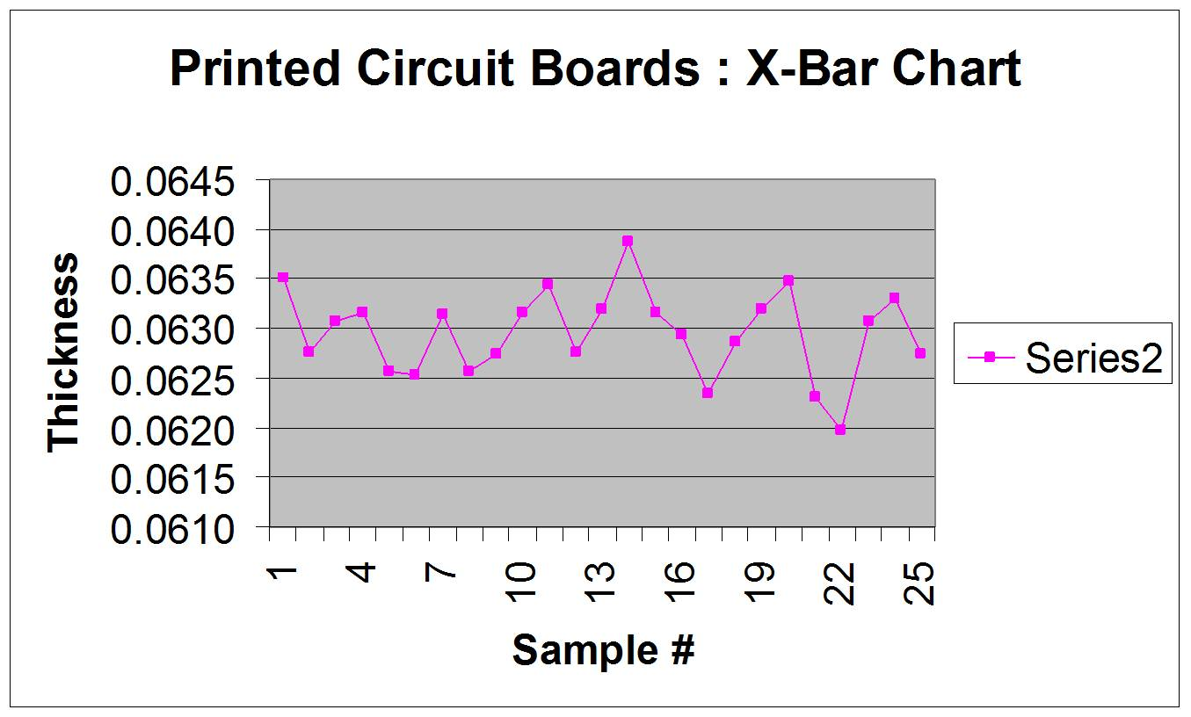
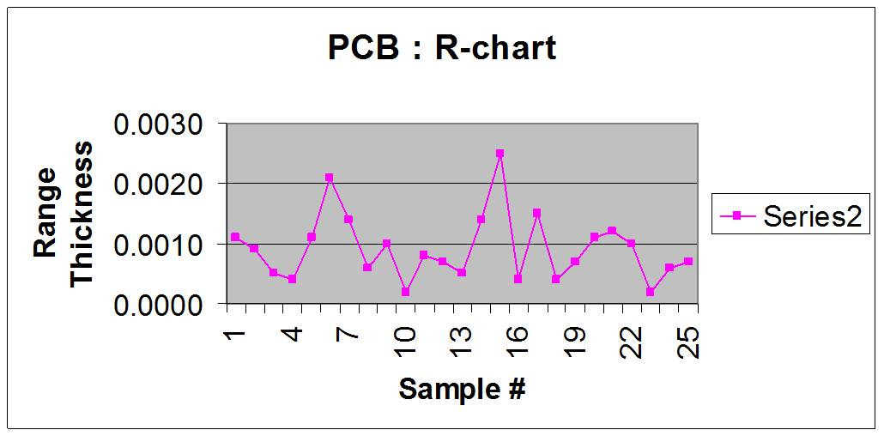
X-bar R charts for Film Thickness
UCL
Target
LCL
UCL
Mean
Notes:
Here is an example of how the R chart and the Xbar charts are used together to analyze a process. Notice that the range variability can be out-of-control while the mean of the measurements is in control. Data points 6 and 15 show an out-of-control range, but an in-control-mean. Whereas data point 22 shows an out-of-control mean and in-control range. Differences such as this help us to better analyze the cause of such problems, because we have even more data. An in-control-range, but out-of-control mean, could indicate a shift in the process mean, where as an OOC range and an in control mean could mean an increase in variability. Whether one or both of these charts is used depends on the product and the process.

Slide 46
Summary
Most process data follows a Normal Distribution
Shewhart or Western Electric Rules can be used to determine if a process goes out of control
scme-support.org
Notes:
Let’s review.
Statistical Process Control (SPC) is a scientific method that can provide much information about a process and how specific process parameters are varying with time. In order to produce a quality product, the amount of variation should be understood and controlled. SPC is a common set of tools used in industry to help manage this variation. Control charts help to identify variation and identify process issues before they begin to affect the product.
All processes have common cause or inherent variation. Most processes also experience some special cause variation. In order to maintain a quality product, it is important to be able to identify special cause variation in order to reduce or eliminate it. Statistical Process Control (SPC) can help to identify and monitor all types of variation.
Understanding the basic mathematical concepts involved with SPC is important in developing and utilizing these tools correctly. Some basic statistical concepts that you should be familiar with are sample median, sample mean, sample range, sample variance, and the square root of the sample variance, the sample standard deviation. Using these basic calculations will assist you in creating a SPC chart to monitor process variation.
Most process data that is monitored in industry follows a normal distribution. With this assumption, it is easy to employ a basic X bar-chart. With knowledge of basic statistical concepts, such as mean, variance, and standard deviation, it is easy to create a SPC chart with upper and lower control limits with which to monitor a specific variable or attribute of a process and the variation of the variable or attribute. You can then use Shewhart rules, which are standard, rules used in industry to help with the identification process.
Statistical Process Control is meant to be used as a tool. It should be used in conjunction with the knowledge and expertise of the technicians and engineers who run a process. The SPC chart can provide valuable information, and when used along with problem solving strategies, it can help to establish and maintain a quality product.

