Slide 1

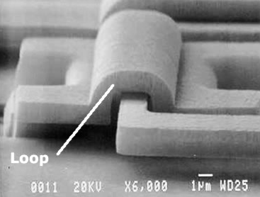
Introduction to Statistical Process Control (SPC)
For Technicians
Support Center for
Microsystems Education
-SCME-
2017
scme-support.org

Slide 2
SCME is a National Science Foundation Advanced Technological Education (ATE) Support Center at the University of New Mexico.
We offer professional development and educational materials to excite and engage community college, university, and high school students and faculty in the field of Microsystems (Micro Electro Mechanical Systems, MEMS) technology.
Support for this work was provided by the National Science Foundation's Advanced Technological Education (ATE) Program through Grants #DUE 1205138 & 1700678 .
SEM of Loop and Hinge System Courtesy of Sandia National Laboratories
scme-support.org

Slide 3
Objectives
Process variation and the need to identify special cause variation
Statistical Process Control (SPC)
Statistical tools necessary to employ SPC
scme-support.org
Notes:
Topics included in this presentation are process variation and the different types of variation that one might see in a manufacturing process, what is SPC, and the statistics necessary to understand and build SPC charts. So let’s get started!

Slide 4



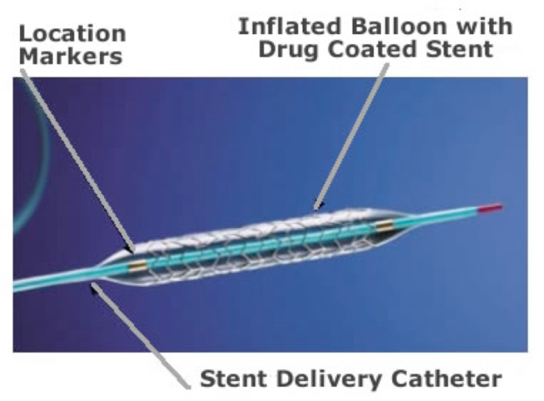
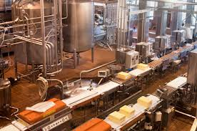
Why do we need (SPC)
Statistical Process Control?
Quality Product
Biochip slide for testing protein arrays
[Image courtesy of Argonne National Laboratories]
Drug-eluting Stent by Taxus [Image provided by the FDA]
Notes:
So what is Statistical Process Control? I think we can all agree that when manufacturing a product, it is desirable to produce a “quality” product. This can be said whether we are talking about cars, food, medicines, or microsystems. There is no universally accepted definition for "Quality”; therefore, this term is subjective and the level of quality is based on the product being made, the customer requirements and the company making the product. But looking at the needs of a customer, we can say that quality is the realization and control of characteristics that determine whether the product will in fact satisfy the customer’s needs. Realization includes the design of the product. Control includes the control of deficiencies in the product minimizing the variation around desired nominal values or "targets“ while meeting product specifications. Just looking at the stent in the lower left corner, as the customer receiving this device, I would definitely want to make sure that it is a quality product.

Slide 5
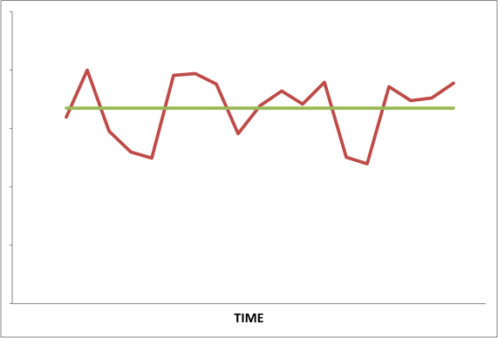
Statistical Process Control (SPC)
SPC is about “control”.
Process
Variation
Target
scme-support.org
Notes:
Statistical Process Control or SPC is a set of tools to help control the deficiencies in the manufacturing of a product, while minimizing the variation around "targets“ or the desired nominal values.
Statistical Process Control (SPC) is used real-time during the manufacturing process where in-line data is attained from the processes that produce the products. Statistical methods are then used to assess whether or not the process is in a state of control. We’ll talk about what “a state of control is” later on. This statistically based process information provides a greater understanding of the process by providing a graphical interpretation of the variation in the process. All processes have some variability over time and that’s what SPC does, is show the state of the process over time.

Slide 6



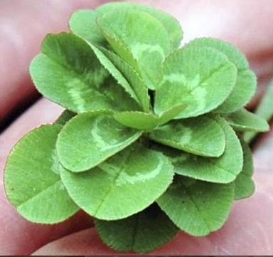

Inherent or Common Cause Variation
Notes:
There are two terms that you heard when we described SPC that are the basis of SPC. One is variation and the other is data. In order to use SPC effectively in a manufacturing process you must first understand variation or variability and its relationship to a particular process step. For data you need to understand the different types of data associated with a process and the type of data you are collecting. The type of data you are gathering and analyzing determines the specific SPC tool or tools that will be used. So let’s talk about variability for a minute.
All products, whether man made or nature made, are not created equal. There is a natural or inherent variation in all processes. In a field of 3 leaf clovers, you won’t have to look too hard to find a 3, 4, 5, or even an 18 leaf clover. When chickens lay eggs, the size, thickness of shell, color of the yoke, number of yokes, and the color of the shell all vary from egg to egg and from chicken to chicken and with the same chicken. As consumers we accept a certain amount of variability in our large, medium and small sized eggs because we know that this variation is natural or, as well call it in manufacturing common cause variation. Common cause variation is that variation that is due to what one might call background noise. For manufacturing, this background noise is due to the sum of a variety of process factors – people, supplies, equipment, process parameters, and environment. There is variation in each of these factors; therefore, there will be variation in the process.

Slide 7
Special Cause Variation
Tracking Your Gas Mileage
Common cause variation
33 mpg
Target
MPG
30 mpg
27 mpg
Special Cause
Variation
Time
Notes:
A process variation that YOU might actually tract is your gas mileage. I know I do. If you track the miles per gallon for your car, you’ll find that there is a certain amount of variation that you find acceptable, expected and normal. When your car is running well, this variation is due to the amount of in town driving vs. highway driving you did that month as well as the quality of gas that you bought. All of these factors make up the background noise and determine the common cause variation or that variation that is inherent to the system. My mpg always increases by about two miles per gallon when I go on a road trip because it’s mostly highway driving and I use cruise control. When I get back into town, the mpg drops. I know this, therefore, I accept a certain amount of variability in my mpg because I know that it is inherent to my particular car. However, if the mpg were to suddenly drop by 5 or 6 miles per gallons, I would want to have my car checked out. That’s not normal. Now I have a different type of variability, one that is not inherent to the system, one that is not predictable, and a variability that is probably due to something going wrong with the system, or in this case the car. This type of variation is called special cause variation or variability.

Slide 8
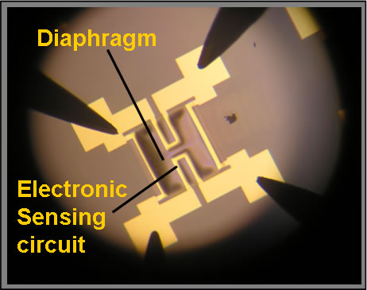
Special Cause Variability
Process Steps:
Silicon Nitride Deposition
Lithography for chamber
Lithography for sensing circuit
Metal deposition for circuit
Metal Removal
Etch reference chamber
Notes:
When considering a manufacturing process, variation can become even more prevalent. Each manufacturing process contains one or more process steps. For example, a micro-pressure sensor’s process may include depositing a layer of silicon nitride (for the membrane or diaphragm) on a bare silicon wafer, followed by a photolithography step and an etch step that patterns the reference chamber hole on the backside of the wafer. Another photolithography step patterns the sensing circuit using photoresist on the front side of the wafer, followed by a metal deposition on top of the photoresist. Subsequent process steps remove the unnecessary metal and etch the reference pressure chamber on the wafer’s backside. This is just a brief summary of a sample micro-pressure sensor process, but as you can see, there are many different process steps required to create this micro-device, eleven in all. Variation of one step can easily affect the variation of subsequent steps. This makes it necessary to minimize the variation and to maintain the “expected” variation in all of these process steps.
Each individual process step has many different parameters or variables. Each of these parameters can vary or drift during the process. For example, in the coat process of the photolithography step, it is desirable to have a specific thickness of photoresist. The resulting thickness depends upon or is a function of the spin speed of the chuck on which the wafer sits, and the actual viscosity of the photoresist deposited on the wafer’s surface. If one or both of these variables change during the coat process for a batch of wafers, then the final thickness of the photoresist will change from one wafer to another. Small changes in these variables are acceptable as ourinherent variation of the process. Any change outside of this inherent variation is unacceptable and the cause must be determined and corrected. Consistency is key and any change in variables that is unacceptable can lead to defects either immediately or in a subsequent process step. This is where SPC comes into play. SPC helps us determine statistically what the inherent variation of the process is, and identify a process that is, as one would say in SPC, “going out of control due a special cause or an unassignable cause”. SPC allows us to identify problems immediately and correct them before they affect others parts of the process.

Slide 9
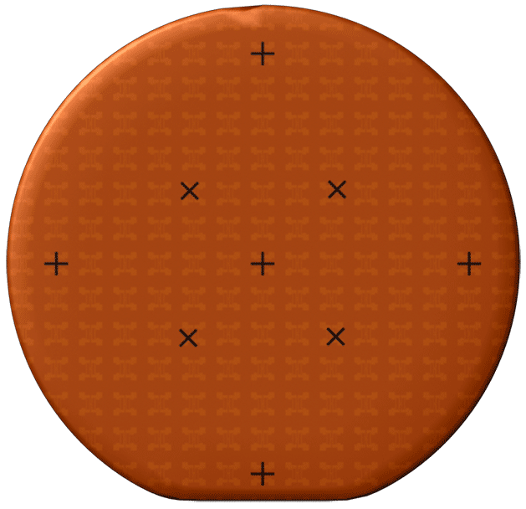
Types of data
Variable Data
  Data Based upon measurements
  Length, time, weight, temperature, pressure, film thickness
Attribute Data
  Data based upon counts (discrete)
  Either there or not
  Number of defects, acceptable or unacceptable
33 mpg
Target
MPG
30 mpg
27 mpg
Time
Notes:
Now let’s talk about data. Two major types of data used in Statistical Process Control (SPC) are variable and attribute data. Data based on measurements is called variable data. Data based on counts is called attribute data.
Variable Data or measureable data is continuous like the length of a cantilever, the temperature of furnace, or your car’s gas mileage.
Attribute Data or data based upon counts is discrete data, pass/fail, on/off, or go/ no go data such as looking for 4-leaf clovers in a field of clover – it has 4 leaves or it doesn’t, it’s a cracked egg or it isn’t.
In the manufacturing of microsystems, variable data is more commonly used and more efficient at detecting out of control (OOC) processes than attributes data. Variables data is continuous and quantitative, meaning that a variable measure can conceptually take on any value in any given interval. Common variables measured include length, yield, time, weight temperature, pressure, line width, and film thickness.
Attributes data is discrete and qualitative or categorical, meaning that the measure can take only a countable number of values in an interval. An attribute is a characteristic that is either there, or not. Common attributes measured include counts, number of defects, fraction defective, failure or success of a finished product, or the number of defective die on a wafer.

Slide 10
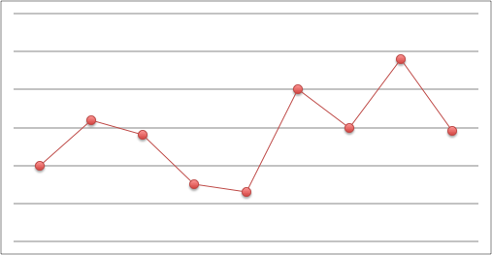
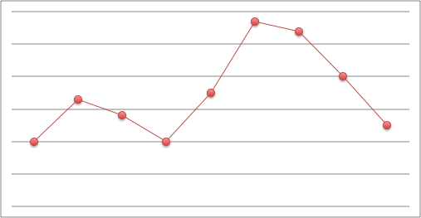
Variability
Photoresist Thickness
Machine#1
Machine#2
1.1 μm
1.0 μm
0.9 μm
Time
Notes:
Just like there are specific types of data, there are Control charts for specifically variable data and attribute data. In the manufacturing industry, the most commonly used data to monitor a process is variable data. The most widely used charts to monitor process parameters or process variables are the mean or X bar-chart and the Range or R-chart.
Statistical Process Control is a system which uses a set of tools to help monitor and control process variability.
Let’s start off with an example of variation just to get our feet wet. Take a look at the following two graphs (which are actually control charts). Each graph shows the resist thickness results for a photoresist application process. The graph on the left is for Machine #1, and it shows the resist thickness applied by one piece of equipment. The graph on the right for Machine #2 shows the resist thickness applied by another piece of equipment. Both Machine #1 and Machine #2 are running the exact same process. Is the process variation over time the same for each piece of equipment? Yes or No?
How would you describe the variability of machine 2compared to machine 1? (higher, lower, or about the same) Write your answers in the chat box.
The correct answer is that the variability is about the same for the first 5 data points, after which machine 2’s variability increases considerably for the next 2 points. As you can see, these charts help to graphically represent different aspects of a process and compare two process lines that supposedly are doing the same thing. These tools are meant to assist engineers and technicians with producing a consistent, quality product regardless of the equipment or process line that it comes from.
Statistically, each machine has been shown in the past to produce a target of a 50 micrometer thickness of photoresist to a wafer, but as the graphs show, the final resist thicknesses begin to vary differently for each machine over time.

Slide 11
Variability
Photoresist Thickness
Day#1
Day#2
1.1 μm
1.0 μm
0.9 μm
Time
Notes:
As we’ve discussed, with any process there are two types of variation: variation that is inherent to the process and variation that is not inherent to the process – common cause variation vs. special cause variation. Let’s return to these two process graphs again. However, this time, let’s assume that the graphs are from the same machine, but on two different days. Do you see a change or changes that may indicate something that is NOT inherent to the system and may be causing the process to go out of control? If you’re thinking yes, Which day and which point or points indicate this?
Go to next slide once people type in their answers.

Slide 12
Variability
Photoresist Thickness
Day#1
Day#2
1.1 μm
1.0 μm
0.9 μm
Time
Common Cause Variation
Controlled Variation
Special Cause Variation
Uncontrolled Variation
Notes:
As you’ll soon learn, the control chart on the left is “in control” and the variation that you see is expected because it has been statistically determined that this is the variability inherent to the process. This is the variation due to the “background noise” of the process. This variation is referred to as “common cause variation” or also as “controlled variation”. However, the control chart on the right tells a different story. Notice the two points outside of the dashed lines. These points represent variation that is neither predictable nor inherent to the system. This type of variation is due to an “assignable cause” that is immediately unknown, but with good troubleshooting skills, can be identified and corrected. Such variation is referred to as “special cause variation”, “assignable cause variation”, or “uncontrolled variation”. If a technician can not determine the reason for the uncontrolled variation and fix it in a short amount of time, a problem solving team should be assigned to determine the cause of this variation and eliminate it from the process. Normally, a special cause like this is due to something having changed – a new bottle of resist, a change in resist viscosity, uncalibrated measuring equipment to measure the thickness, or sudden change in spin speed due to a problem with the spin motor. It could also be due to human error – a new employee that didn’t follow procedure or didn’t know how to measure the resist correctly. Once the cause of this variation is found and corrected, the process returns to normal as you can see with the next two data points.
The terms controlled and uncontrolled variation are commonly used when referring to control charts. As you can see from this example, control charts used in SPC help determine which type of variation (controlled or uncontrolled) is present. As a result, control charts can help determine the best course of action.

Slide 13
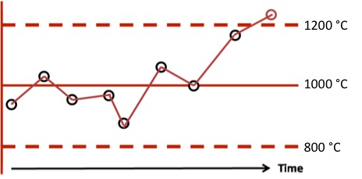
Another Example
Process Temperature
Time
Notes:
Let’s look at another example. Take a look at the control chart shown here that is tracking process temperature. As you can see, there is a sudden increase in temperature and the last data point is outside the upper line or what is called the upper control limit of 1200 °C. At the point, the technician’s standard operating procedure would probably be to stop the process and determine the cause of the temperature spike.
By monitoring the process this way, it is easy to pick up on a process change such as the temperature increase. Normally, there was something out of the ordinary that occurred to allow the temperature to rise out of the acceptable range. After an investigation, an example of a root cause for this sudden jump in temperature may simply be due to not enough coolant in the cooling system. The cooling system could be checked, if a coolant is needed, than it would be added to alleviate the problem. If that was the cause of the problem, then the collected data on the next run would show the process back in control. If not, further investigation into the cause of the problem would be required.

Slide 14
Desired Variation
Can you think of a product where a certain amount of variation is acceptable?
Notes:
How much variation is too much? That depends on the product. There are some cases where limited variation is intentionally built into the process. Can you think of a product where variation is desired? Write your answer in the chat box. (We need to come up with some example here while they write their answer in. Maybe we can animate the next slide.)

Slide 15


Desired Variation
Can you think of a product where a certain amount of variation is acceptable?
Notes:
Many hand made products are valued because of the inherent variation, such as hand carved furniture, pottery, and jewelry. No one wants to buy an expensive piece of pottery or piece of art that is exactly like someone elses.
Let’s see what you came up with.
There are also products for which a certain amount of variation is acceptable or not even recognizable by the consumer, such as the color of a car, the weight of a box of cereal, or the thread count in a set of sheets. In all of these the variation must be pretty big to be noticeable by the consumer. Therefore, the controls are relatively loose compared with those controls used in microsystems fabrication.

Slide 16
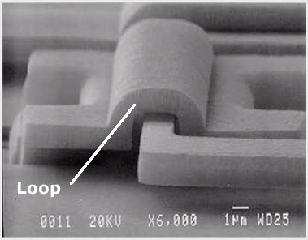
Variation in Microsystems
Hinge System
[Image courtesy of Sandia National Laboratories]
Notes:
Microsystems fabrication seeks to have as little variation as possible. Microsystems deal in micrometers and nanometers, not centimeters and inches. Because of the extremely small feature sizes (1 µm to 100 µm) and precise alignment (sometimes in the nano range), microsystems fabrication needs to be on “target” from step to step, over hundreds of steps. Remember the example of the micro pressure sensor process? There are so many steps involved in microsystems fabrication that when variation occurs at one step, it can perpetuate and affect other steps along the way.
A microsystems example is this hinge system. The height of the loop and the hinge is approximately 1 µm. The hinge must be free to rotate within the loop. Can you see the importance of variability reduction or even elimination in the fabrication of this device? Variation would need to be absolutely minimized and controlled during the process in order for the hinge to be able to rotate within the loop.

Slide 17
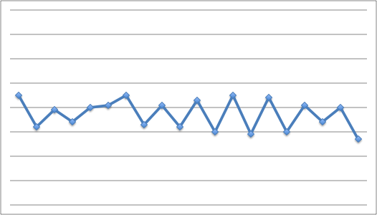
Statistical Process Control and Variation
Upper Control Limit
Centerline
Lower Control Limit
Notes:
Statistical Process Control assists in the proper management of variation. Special Cause variation or uncontrolled variation is monitored and controlled with control charts, and as technicians, it is important to understand the basic concepts behind these charts.
In-line variation reduction is a major goal of Statistical Process Control. Interestingly, the way in which products and process characteristics vary about some desired target value could actually provide valuable information that can be used to understand, control, and reduce the variation. With predictable processes that also have less variation, the manufacturer is better able to change or control things to provide improved products that are more consistent and on target. More consistent products that are on target require less inspection, scrap, and rework. An erratic process full of variation is similar to the automobile that has a lot of play in the steering mechanism. You have little control and less freedom in the driver's seat as you have to keep adjusting and hoping you will stay on the road.
Common cause variation is what is generally used to determine the natural variation of a process, which in turn is commonly used to develop the control limits, both upper and lower.
Technicians generally monitor the process for special cause variation and engineers work at understanding, controlling, and even reducing common cause variation.

Slide 18
Communication is KEY!
Technicians
Management
Operators
Engineers
Communication
Notes:
It is important to emphasize that communication is essential between operators, technicians, engineers, and management in order to understand and remedy both common and special cause variation. Changes should never be made to a process without properly following the protocol in place in a manufacturing facility. Changes could affect all processes run on each piece of equipment, and equipment is often shared between different processes and products. In addition, any change in one part of the process can cause change in subsequent steps of the process causing a domino effect. Therefore, any process change must be communicated and agreed upon.

Slide 19
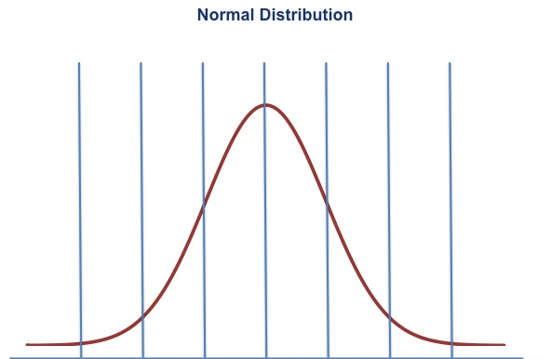
Statistics for Statistical Process Control
Statistics for Central Tendency
  Sample Median
  Sample Mean
Statistics for Variability
  Sample Range
  Sample Variance
  Sample Standard Deviation
Notes:
OK, now we understand common cause and special cause variation and how it is important to monitor and control both types of variation. How do we do this?
In order to understand the basics of Statistical Process Control (SPC), there are several statistical concepts you should be familiar with. These concepts are used to provide basic analytical descriptions of data. Most often in manufacturing, statistical analysis is usually done on a sample of data; so the statistics that we will cover here, will be for a sample set of data. All calculations will use the data from the sample.
The statistical calculations include sample median, sample mean, sample variance, sample range, and sample standard deviations. We will briefly discuss these statistical concepts that you will need to understand in order to employ SPC.

Slide 20
Sample Median – Central Tendency
Sample Median
  Represents the data value that is “physically” in the middle of the sample set when arranged in numerical order.
  Example:
  Given the data set: 2,4,1,5,3
  Order the data: 1,2,3,4,5
  Question: What is the Median?
scme-support.org
Notes:
One set of calculations involved in SPC identifies the central tendency of the sample data. The term central tendency basically refers to the way in which data tend to cluster around a particular value. Statistics used in SPC that measure central tendency are the sample median and mean.
The Sample Median represents the data value that is “physically” in the middle of the SAMPLE set when arranged in numerical order or the middle value that separates the higher half from the lower half of the data set.
To obtain the sample median, first put the numbers into ascending order. Let’s look at an example. Suppose the sample was (2, 4, 1, 5, 3). Ordering the data we have (1, 2, 3, 4, 5).
So here is a question for you, what is the Median? Type your answer in the chat box

Slide 21
Sample Median – Central Tendency
Sample Median
  Represents the data value that is “physically” in the middle of the sample set when arranged in numerical order.
  Example:
  Given the data set: 2, 4, 1, 5, 3
  Order the data: 1,2,3,4,5
  Example:
  Given the data set: 2, 4 ,1, 5, 1 ,3
  Order the data: 1, 1, 2, 3, 4, 5
  Median is the average of the 2 middle #’s: 2 and 3
  Median = 2.5
Notes:
If you said 3, then you are correct. Ok that was easy, but suppose the sample was (2, 4, 1, 5, 1, 3). Ordering the data we have (1, 1, 2, 3, 4, 5). The two middle numbers are 2 and 3; thus, the median would be the average of 2 and 3, or 2.5.

Slide 22
Sample Mean – Central Tendency
Mean
Universal or Arithmetic Mean = μ
Sample Mean = X
Mean of a collection of sample Means = X
Calculation of Mean
5 Resist Thickness Values: 2.87, 2.99, 3.01, 3.15, 2.98 Microns
μ = X = 2.87 + 2.99+ 3.01+ 3.15 + 2.98
= 3.00 microns
Sample Mean
5
Notes:
The Sample Mean is the central location of the sample data on a number line. This central location is the “target” that was referred to previously, or the center of the distribution.
Median and Mean should be a review for you, but just to get the statistical terminology straight, the Universal or arithmetic mean is represented by μυ, this means the mean of ALL data. But remember, with SPC we are usually talking about the mean of a SAMPLE set of data, therefore, the Sample Mean is represented by X-bar. And just to make it more complicated, very often, the data that is used in Statistical Process Control Charts is the mean of a set of means from a sample. This mean of a collection of sample means is represented by X bar bar. Let’s review how the mean is calculated and then we will look at an example.
Given a set of n data values, the arithmetic mean, mu, of a set of data is the sum of the data values, x_{n}, divided by the number of data values (n):
When a set of data is identified as a sample, the arithmetic mean is calculated for the set of data, but can sometimes be represented as X bar.
Let’s look at an example, let’s say we have a sample set of 5 measured photoresist thickness values (2.87,2.99,3.01,3.15,2.98) microns. If we add up the values and divide by the number of data values we have, which is five, then the Xbar or sample mean is 3.00 microns.

Slide 23
What is X ?
X
Wafer #1 Sample Mean
Wafer #2 Sample Mean
Wafer #3 Sample Mean
Wafer #4 Sample Mean
X = 3.48 microns
X = 3.32 microns
X = 2.72 microns
X = 2.49 microns
X = 3.48 + 3.32 + 2.72 + 2.49
= 3.00 microns
4
Notes:
Now let’s look at what we mean by X bar bar.
Let’s take an example of a wafer that has just been deposited with photoresist and the process parameter or the value to be measured is resist thickness in Microns.
In this manufacturing facility, there are 25 wafers per batch or lot and roughly 150 devices per wafer. In this case, if we were to measure the resist thickness on each device, on each wafer, we would be measuring and plotting resist thickness values on SPC charts all day!
So, the process engineer has decided that we will pick 4 wafers in a lot and acquire a SAMPLE of 5 measurements from the same spot on each of the four different wafers. The resist thickness was measured at each of these five locations. We calculate a Xbar value or sample mean for each wafer, then, we calculate a Xbar bar value for each lot. Therefore for the lot that contained these particular 4 wafers, the sample mean was also 3.00 microns. This xbar bar data is used to come up with a target or centerline value for an X bar chart.

Slide 24
Sample Range
Statistics for Variability
Statistics for Variability
  Sample Range
  Sample Variance
  Sample Standard Deviation
Sample Range
  The difference between the maximum value minus the minimum value.
  2.87, 2.99, 3.01, 3.15, 2.98
Question – What is the Sample Range?
scme-support.org
Notes:
Another set of statistical calculations used in SPC addresses variability or dispersion in the sample data. The statistics that are usually calculated are the sample range, sample variance, and the square root of the sample variance, which is called, sample standard deviation.
The Sample Range is the spread of the distribution of the data, or more simply put – the difference between the maximum value minus the minimum value. For example, given the following sample data measurements, what would be the sample range?
Enter your answer in the chat box.

Slide 25
Sample Range
Statistics for Variability
Statistics for Variability
  Sample Range
  Sample Variance
  Sample Standard Deviation
Sample Range
  The difference between the maximum value minus the minimum value.
  2.87, 2.99, 3.01, 3.15, 2.98
  3.15 – 2.87 = 0.28 Sample Range
scme-support.org
Notes:
Well if you said it would be 3.15(the greatest value in the data set) minus 2.87 (the minimum value), the range would equal 0.28.

Slide 26
Sample Variance
Statistics for Variability
Sample Variance
  How far a set of numbers are spread out.
5 Resist Thickness Values: 2.87, 2.99, 3.01, 3.15, 2.98 microns
Mean = 3.00 microns
σ² = 0.01 Square Microns
scme-support.org
Notes:
The Sample Variance is an averaged squared difference between the individual measurements and the mean. Or more simply, how far a set of numbers are spread out. Understanding how far the numbers are from the mean is just one of the statistical characteristics which can help us to understand the nature of the process. Variance is represented by the following equation. Where σ2 is sample variance, x_{i} are the individual sample data values, μ is the sample mean, and n is the number of sample data values.
Let’s use our sample set of 5 measured photoresist thickness values (2.87, 2.99, 3.01, 3.15, 2.98 ) microns and sample mean (μ=3.00 microns). We have five data values here, so our n is equal to 5. Plugging these values into the variance equation, we come up with 0.01 square microns

Slide 27
Sample Standard Deviation
Statistics for Variability
Sample Standard Deviation
  Measurement of how the data are distributed around the sample mean and within a range of values.
  σ² = 0.01 micron²
  σ = 0.1 micron
scme-support.org
Notes:
The Sample Standard Deviation is the square root of the Sample Variance. So basically it is a measurement of how the data values are distributed around the sample mean and within the range of values. This is one of the most important calculations for SPC analysis and is used to develop control charts. Both common cause variation and special cause variation rely on the standard deviation for analysis. This will be discussed in detail shortly.
Simply put, the Sample Standard Deviation is the square root of the Sample Variance. Using our example, since our Sample Variance is equal to 0.01 square micron, then the Sample Standard Deviation is the square root of that, which is 0.1 Microns

Slide 28
Summary
SPC is a statistical scientific method that provides valuable information about a process
This type of variation (common and special cause) should be understood and controlled.
Statistical Concepts used in SPC
  Sample median
  Sample mean – μ, X, X
  Sample range - R
  Sample variance – σ²
  Sample standard deviation – σ
scme-support.org
Notes:
Let’s review.
Statistical Process Control (SPC) is a scientific method that can provide much information about a process and how specific process parameters are varying with time. In order to produce a quality product, the amount of variation should be understood and controlled. SPC is a common set of tools used in industry to help manage this variation. Control charts help to identify variation and identify process issues before they begin to affect the product.
All processes have common cause or inherent variation. Most processes also experience some special cause variation. In order to maintain a quality product, it is important to be able to identify special cause variation in order to reduce or eliminate it. Statistical Process Control (SPC) can help to identify and monitor all types of variation.
Understanding the basic mathematical concepts involved with SPC is important in developing and utilizing these tools correctly. Some basic statistical concepts that you should be familiar with are sample median, sample mean, sample range, sample variance, and the square root of the sample variance, the sample standard deviation. Using these basic calculations will assist you in creating a SPC chart to monitor process variation.
Most process data that is monitored in industry follows a normal distribution. With this assumption, it is easy to employ a basic X bar-chart. With knowledge of basic statistical concepts, such as mean, variance, and standard deviation, it is easy to create a SPC chart with upper and lower control limits with which to monitor a specific variable or attribute of a process and the variation of the variable or attribute. You can then use Shewhart rules, which are standard, rules used in industry to help with the identification process.
Statistical Process Control is meant to be used as a tool. It should be used in conjunction with the knowledge and expertise of the technicians and engineers who run a process. The SPC chart can provide valuable information, and when used along with problem solving strategies, it can help to establish and maintain a quality product.

